Slide 1
EN-WRMT: Platform Administrator Training for Web Platform
Training of Trainers in Eastern Nile Water Resources Models and Tools
6 – 10 May 2025
Miss Beimnet Girma, Mr. Kedir Hajisheko and Dr. Binyam Tesfaw Hailu,

Slide 2
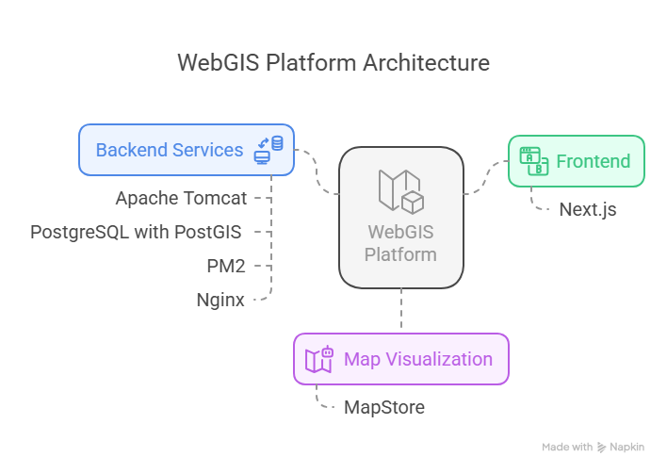
System Architecture

Slide 3
System Architecture
http://localhost:8080/….

Slide 4
System Architecture
http://localhost:8080/….

Slide 5
First Things First
Check if node and npm are installed.
Open “Command Prompt” and run the following 2 commands:
> node -v
> npm -v

Slide 6
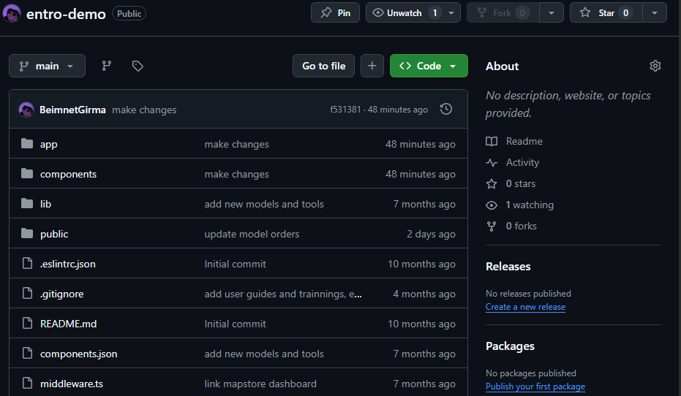
Get the Code
The source code for the platform’s frontend is available on a demo github repository at https://github.com/BeimnetGirma/entro-demo

Slide 7
Get the Code
You can download the repository onto your computer via the git command.
Steps:
Create a folder where you want to download the code into.
Open up a command prompt shell at that location
Type in and hit run
> git clone https://github.com/BeimnetGirma/entro-demo.git .

Slide 8
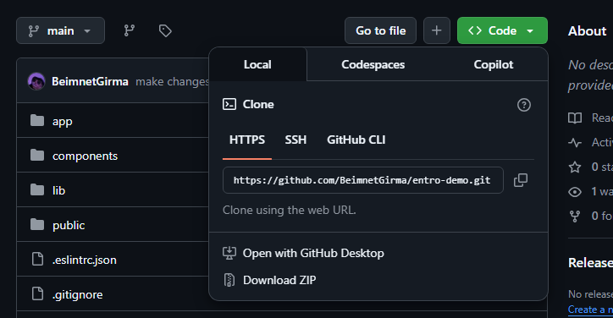
If you don’t have git installed on your computer…
You can:
Install it the winget tool and typing out the following in the command prompt shell:
> winget install --id Git.Git -e --source winget
Install it by running the shared installer
Or you can forget about git and just download the zipped repository

Slide 9
If you don’t have git installed on your computer…
3. Or you can forget about git and just download the zipped repository
1
2

Slide 10
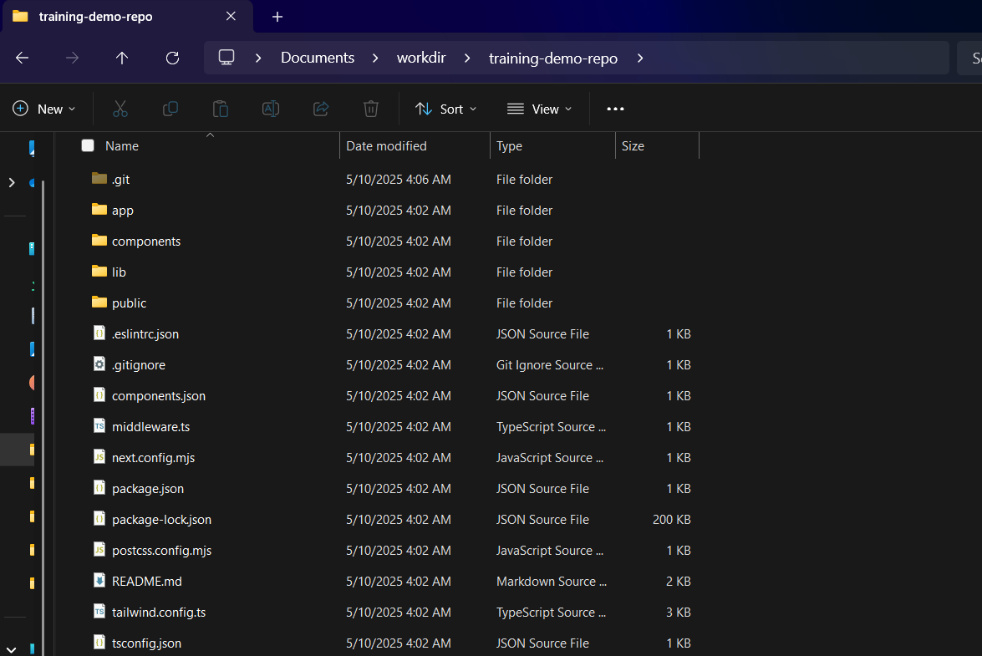

Slide 11
Now that you have the code locally
Navigate to where you have the code (unzip if necessary)
Open a shell (command prompt or other) in the code folder
Install all necessary packages needed by the project by running:
> npm install _
Once complete run your application in server mode by running:
> npm run dev _
If successful, your application will be available at http://localhost:3000

Slide 12
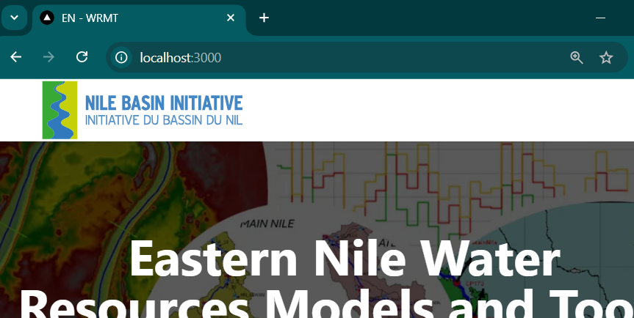

Slide 13
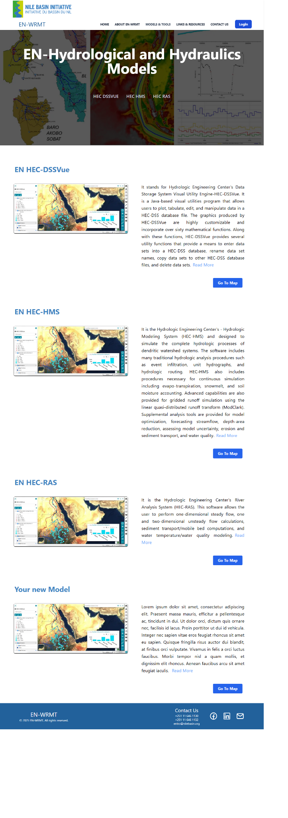
Open Hydrological and Hydraulics Models

Slide 14
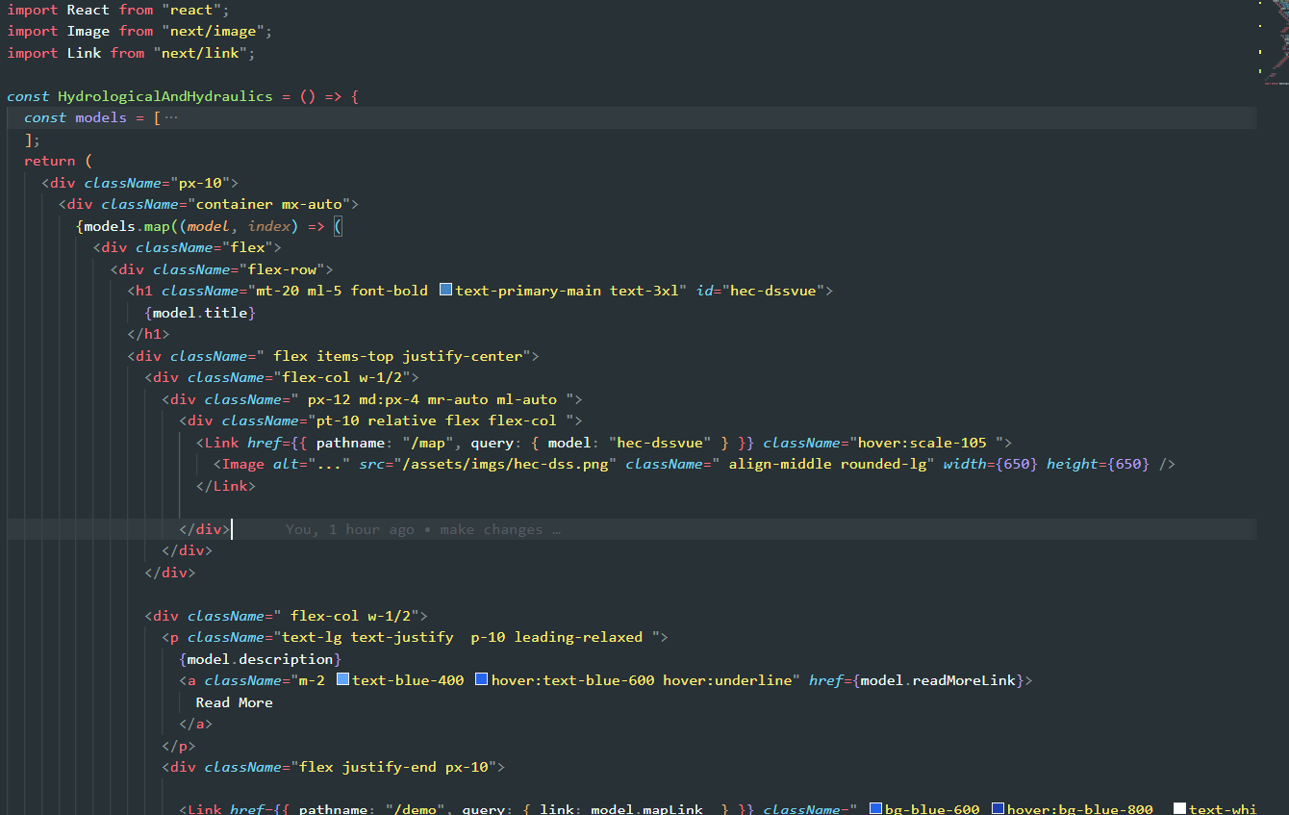
Connect to your map
In your source code folder, navigate to components > open file hydrologicalAndHydraulics.tsx

Slide 15
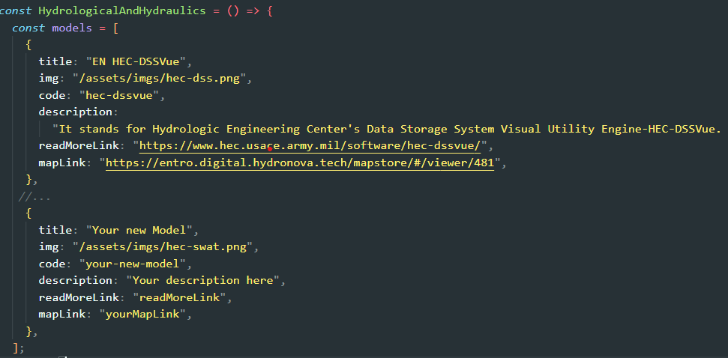
Connect to your map

Slide 16
Connect to your map
http://localhost:8080/….

Slide 17
Connect to your map
Now save the file
Go to your browser and click on the “Go to Map” link.

Slide 18
Where does the platform actually run?
A linux computer at a remote location
Currently that computer’s address is - enwrmt.nilebasin.org
Public IP:20.42.83.139
OS: ubuntu 24.04 LTS
2vCPUs, 8GB RAM

Slide 19
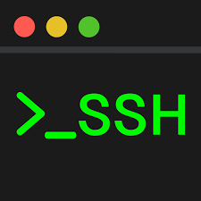
Running the Services
enwrmt.nilebasin.org
3000
22
8080
443
80
5432

Slide 20
Running the Services
enwrmt.nilebasin.org
3000
22
8080
443
80
5432

Slide 21
Nginx

Slide 22
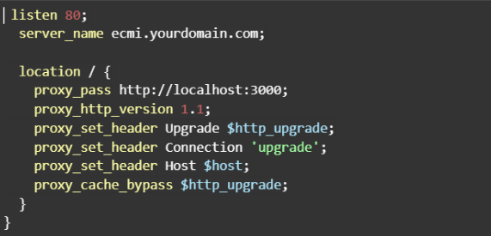
Nginx Configuration

Slide 23
Running the Services
enwrmt.nilebasin.org
3000
22
8080
443
80
5432

Slide 24
Running the Services
enwrmt.nilebasin.org
x
3000
22
x
8080
443
80
x
5432

Slide 25
Port Management with UFW
Check Exposed Ports
> sudo ufw status _
Allow or Deny Port Access
> sudo ufw allow [port][/protocol] _
> sudo ufw deny [port][/protocol] _

Slide 26
Running the Services
enwrmt.nilebasin.org
x
3000
22
x
8080
443
80
x
5432

Slide 27
Running the Services
enwrmt.nilebasin.org
x
3000
22
x
8080
443
80
x
5432

Slide 28
Running the Services
enwrmt.nilebasin.org
x
3000
22
x
8080
80
*
*
*
*
*
*
*
*
*
*
*
*
*
*
*
*
*
443
x
5432

Slide 29
Setup SSL Certificate
Let’s Encrypt is used to issue free, automated certificates.
a free, automated, and open Certificate Authority (CA) that provides SSL/TLS certificates for websites, enabling secure HTTPS connections.
run by the nonprofit Internet Security Research Group.
Certbot handles certificate installation and renewal.
Tool used to obtain and manage SSL certificates

Slide 30
Setup SSL Certificate
Steps:
Install certbot by running:
> sudo apt install certbot python3-certbot-nginx _
Obtain certificate:
>sudo certbot --nginx -d [yrdomain.com] _
Renew certificate:
>certbot renew _

Slide 31
Running the Services
enwrmt.nilebasin.org
x
3000
22
x
8080
80
*
*
*
*
*
*
*
*
*
*
*
*
*
*
*
*
*
443
x
5432

Slide 32
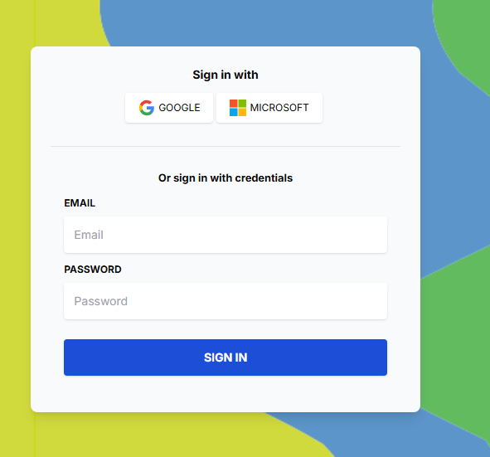
Clerk
provides authentication and user management solutions for web applications.

Slide 33
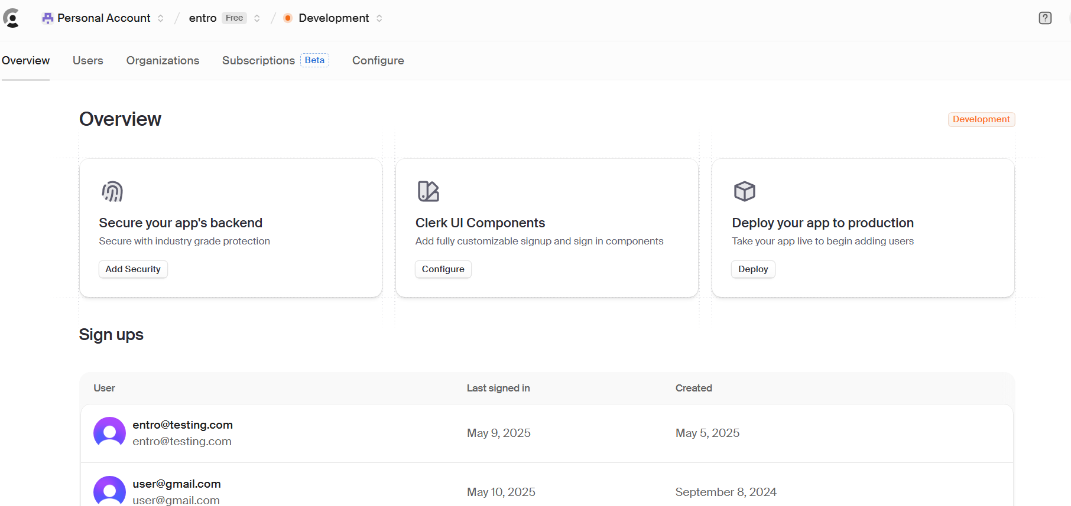
Clerk

Slide 34
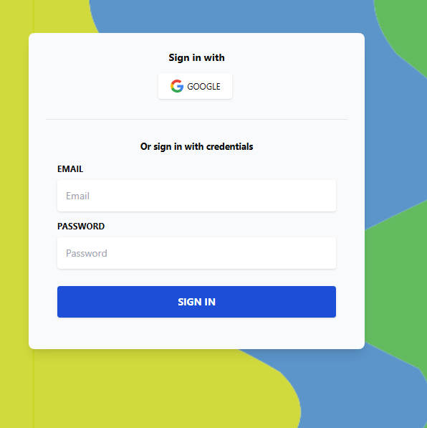
Login Flow
👍 👎
entro.digital.hydronova.tech
x
3000
22
x
8080
80
443
x
5432

Slide 35
Changing/ Updating Models
root directory > public > files

Slide 36
Changing/ Updating Models
> scp -r [local/path/to/folder] username@host_name[path/to/destination]

